Slide 1
Acquisition of human behavior data through multiple sensors
NITU SHARAFF

Slide 2
CONTENTS
Objective
Scenario
Equipment
a) Eye trackers
b) Facial Expression
c) ECG
d) GSR
e) Hand Movement
f) EEG
g) Seat pressure
Integration solutions
a) IMOTIONS
b) NOLDUS
5) Comparing platforms

Slide 3
WHAT IS THE OBJECTIVE?
The aim of the project is to acquire human behavior data through different sensors.
In broad terms, to find the right integration of different hardware equipment along with the software and to synchronize all the data with respect to time.

Slide 4
CONTENTS
Objective
Scenario
Equipment
a) Eye trackers
b) Facial Expression
c) ECG
d) GSR
e) Hand Movement
f) EEG
g) Seat pressure
Integration solutions
a) IMOTIONS
b) NOLDUS
5) Comparing platforms

Slide 5
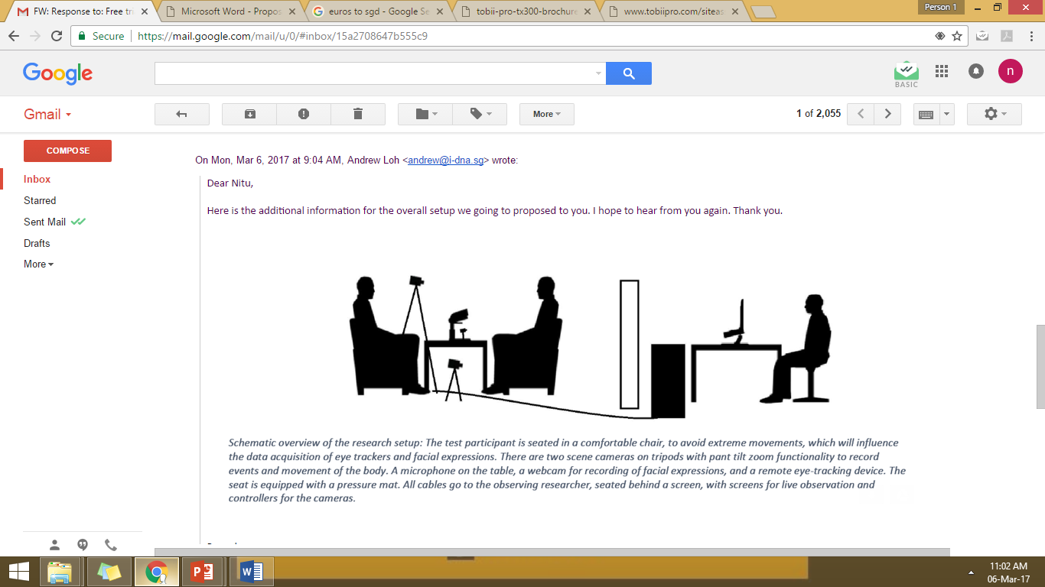
SCENARIO
We set up a face-to-face or a computer software based interview where the subject responds to the questions asked.
Sensors would be set up to acquire data
RGB CAMERA for face/body
Eye trackers for pupil size
Wristbands for ECG
Finger straps for GSR
Sensors on chairs for seat pressure
EEG for brain waves

Slide 6
CONTENTS
Objective
Scenario
Equipment
a) Eye trackers
b) Facial Expression
c) ECG
d) GSR
e) Hand Movement
f) EEG
g) Seat pressure
Integration solutions
a) IMOTIONS
b) NOLDUS
5) Comparing platforms

Slide 7
EYE TRACKING
Top 3 players in eye tracking based on number of publications [1] are:
1. Tobii – 9230 Publications (www.tobiipro.com)
2. SMI - 6040 Publications
3. Eyelink – 5530 Publications
(as on Jan 2017)
In order to keep a track of eyes during sideways/up-down head movements and to reduce interference with the IR sensors (Microsoft Kinect), we should prefer mobile devices to remote devices.
For pupil dilation measurements, we require a sampling rate of 50-60Hz.
[1] https://imotions.com/blog/top-eye-tracking-hardware-companies/

Slide 8
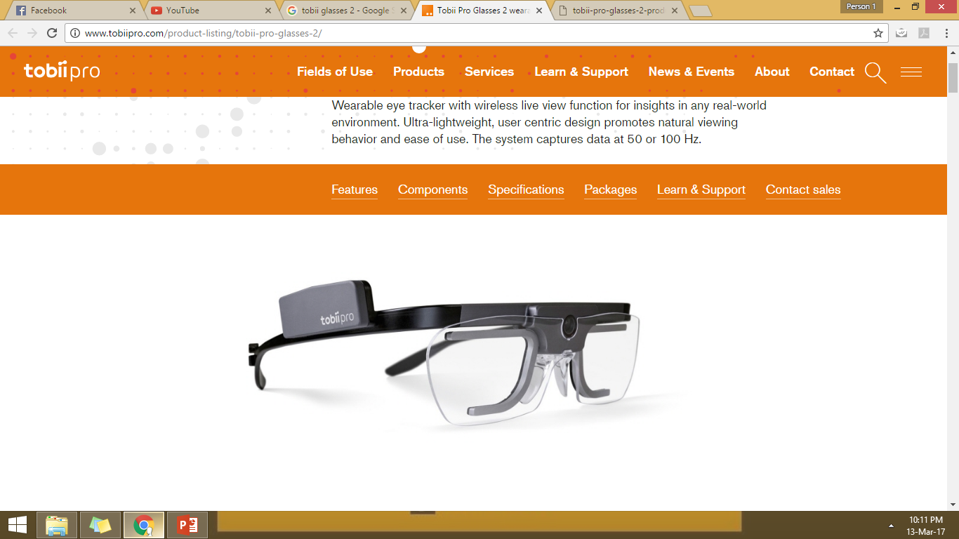
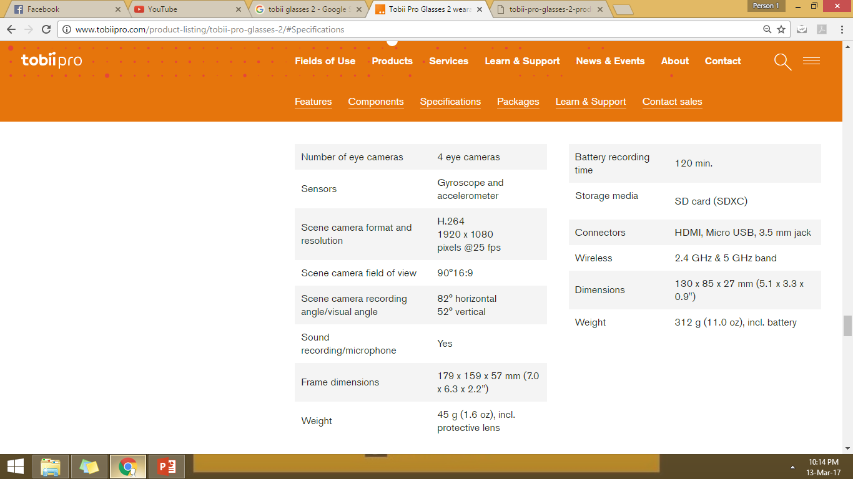
TOBII GLASSES PRO 2
ADVANTAGES
It is transparent from the front and will not interfere with facial expressions.
It can be sampled at 50Hz or 100 Hz based on the chosen glasses.
It measures pupil dilation.

Slide 9
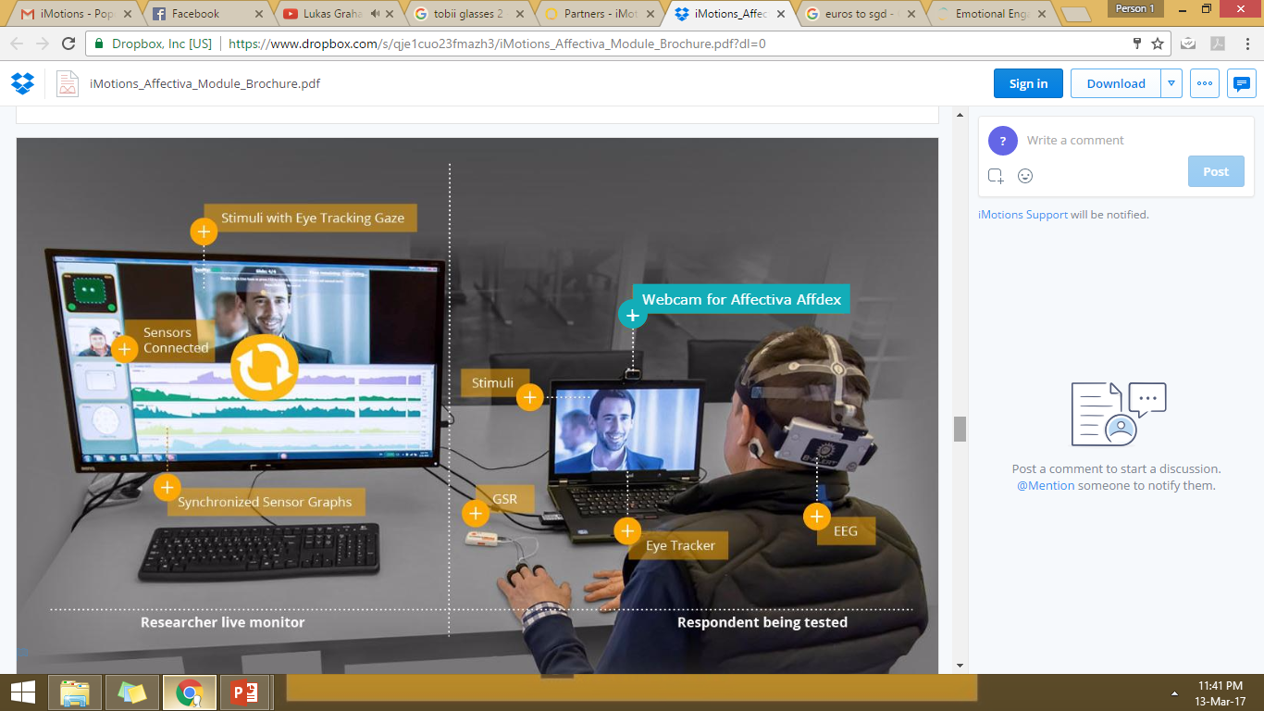
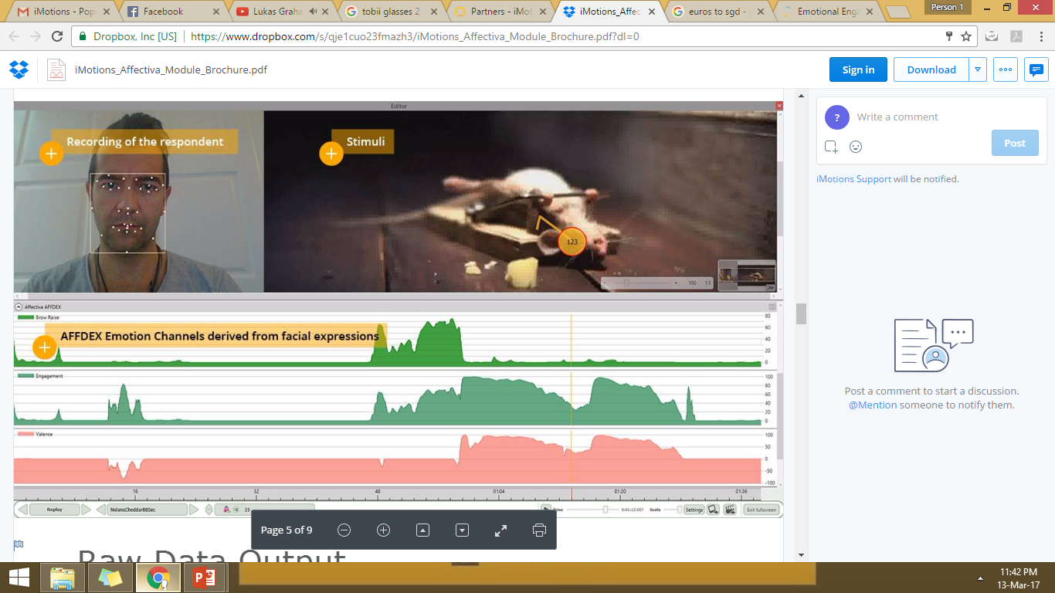
FACIAL EXPRESSIONS
Most widely used tools for facial expressions:
Affdex by Affectiva
Face Reader by Noldus
The Computer Expression Recognition Toolbox (CERT) by The Machine Perception Lab at University of. California
Track : 7 Basic Emotions: Joy, Anger, Surprise, Fear, Sadness, Disgust, Contempt.

Slide 10
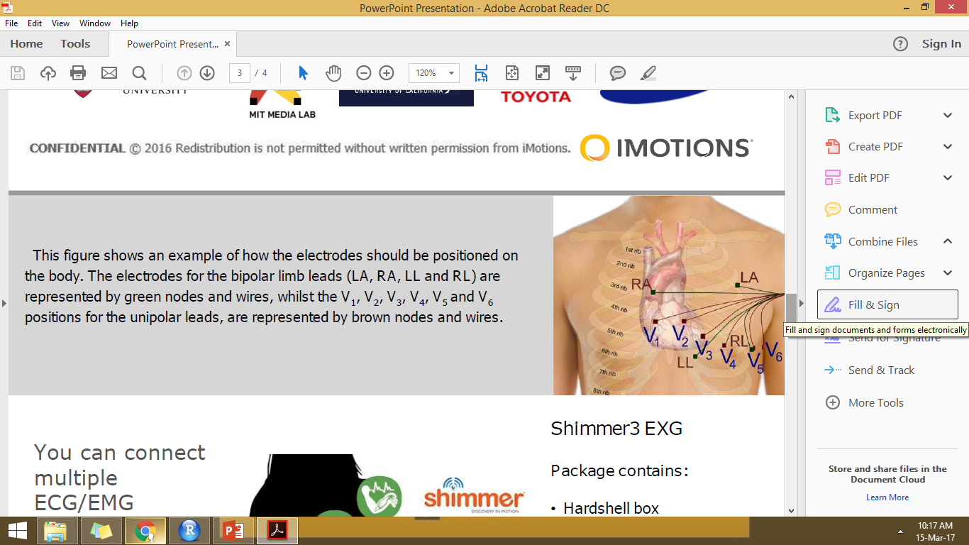
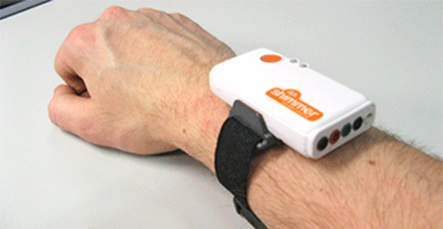
ECG USING SHIMMER 3
ECG Measurements are usually done by placing electrodes on the chest for good results as placing on a wristband gives somewhat noisy data.
ECG measurements provides the best heart rate and blood pressure but only by chest and similar measurements can be obtained using GSR.

Slide 11
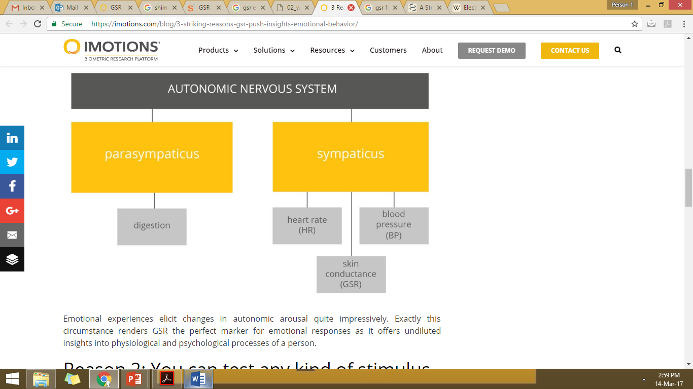
Galvanic Skin Response (GSR)
Measures an increases in perspiration at the surface of the skin, a byproduct of sympathetic nervous system activity, GSR represents a measure of arousal or interest.
With GSR, we can tap into unconscious behavior that is not under our cognitive control.

Slide 12
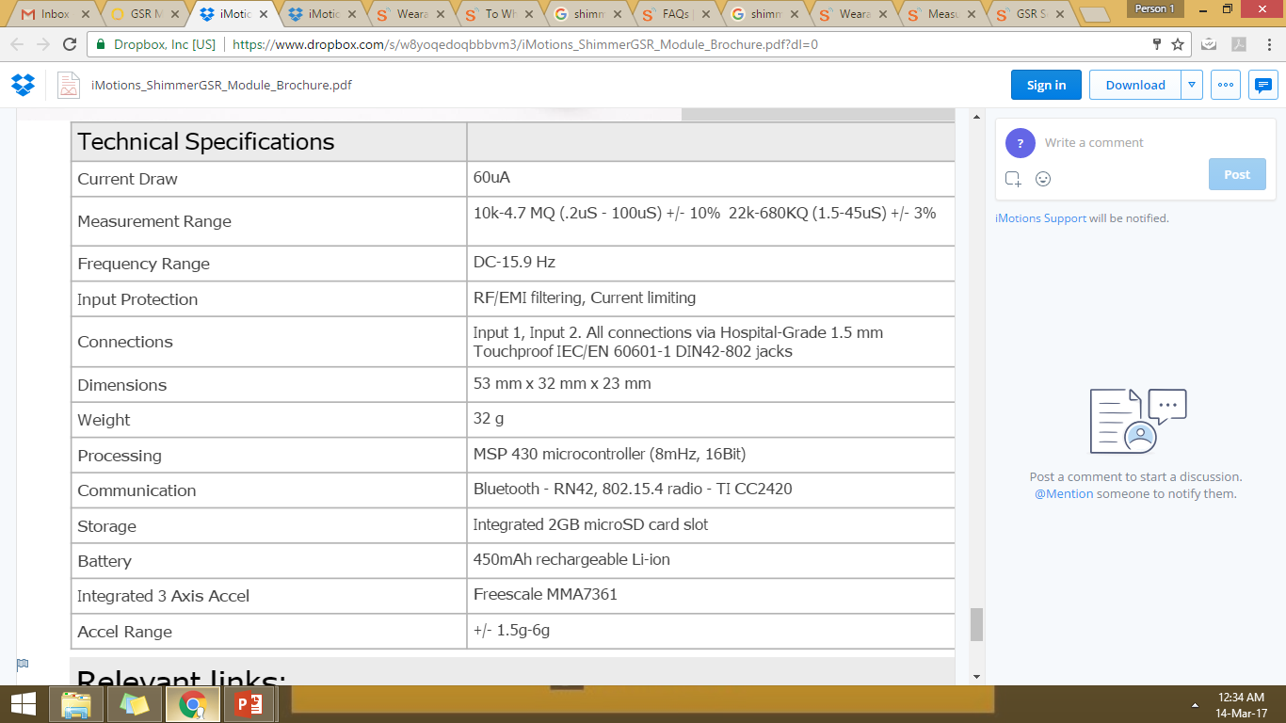
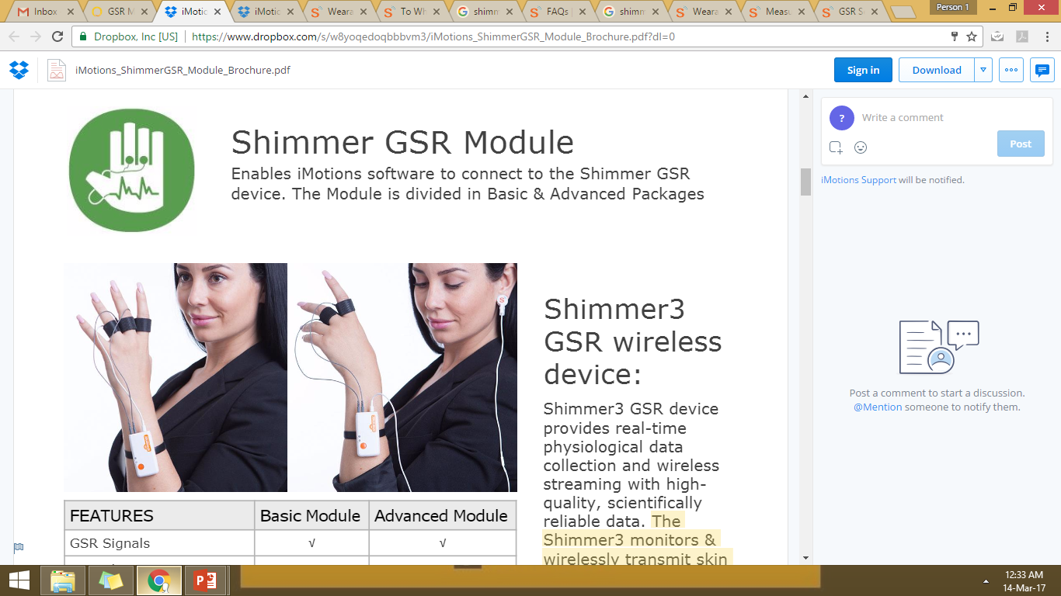
GSR Measurements with Shimmer 3

Slide 13
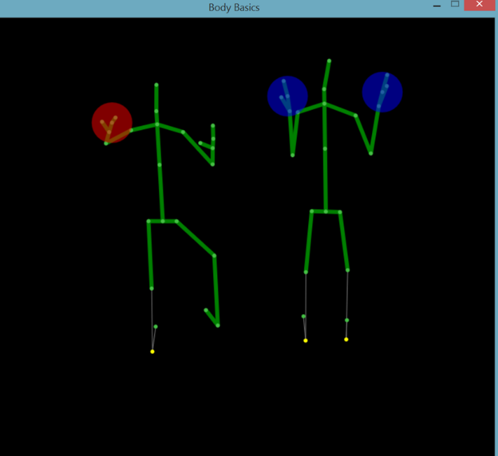
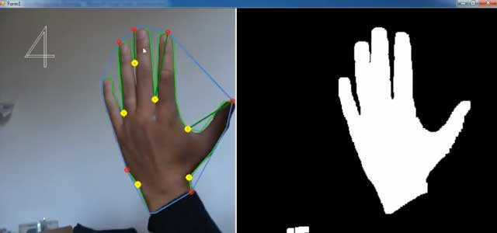
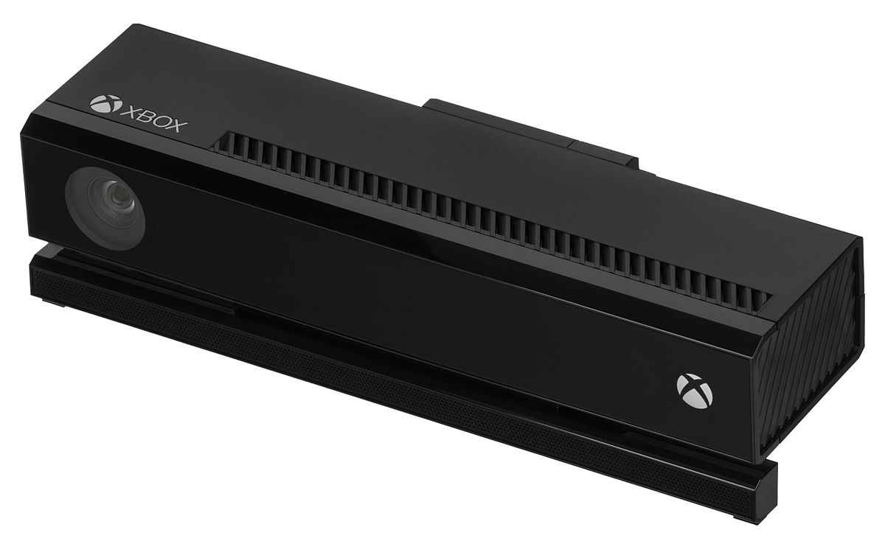
Hands/Body movement RGB Cameras
Microsoft Kinect provides both RGB data and depth data (through IR sensors) for detection of hands and gesture recognition.
It can also provide a skeleton of hands/body of the subject to observe movements in the body.

Slide 14
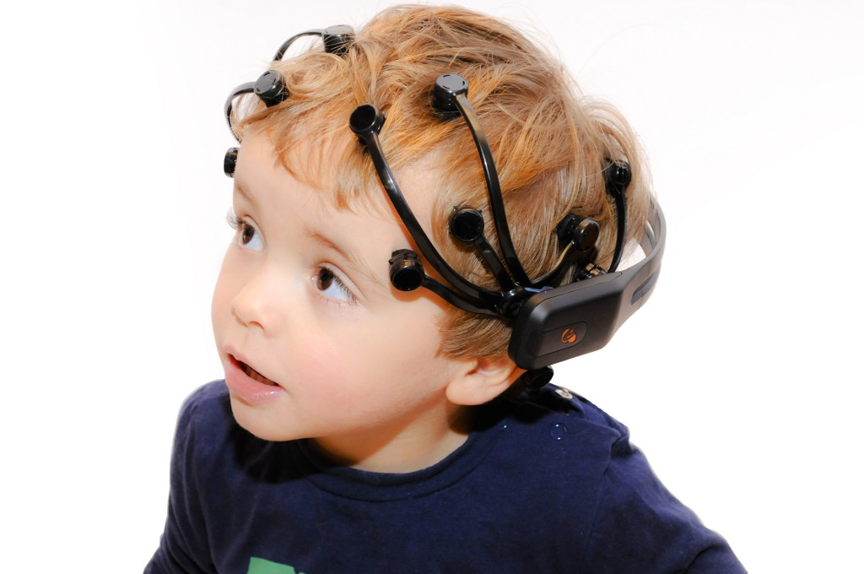
EEG MEASUREMENTS
EEG measurement requires electrodes being set up on the head. The more the number of channels better is the data. But a lot of electrodes can be invasive and make the subject uncomfortable leading to improper results.
Used to study: High Engagement
Engagement
Distraction
Drowsiness
Workload
Stress
Most widely used EEG devices:
Emotiv Epoc – 14 channels
ABM B-Alert X-Series EEG – 24 channels

Slide 15
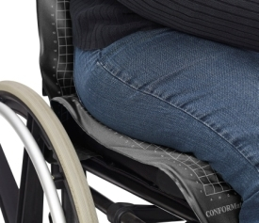
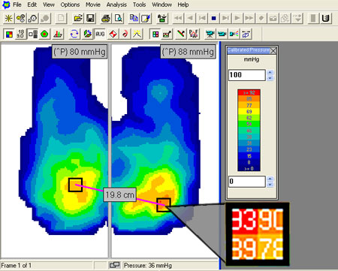
Seat Pressure – Tekscan Conformat
CONVERSATION WITH TEKSCAN SELLER IN SINGAPORE:
An extremely comfortable chair with sensors provided at the back and on seat. The price ranges from 40-60K for a wireless system with/without SDK.

Slide 16
CONTENTS
Objective
Scenario
Equipment
a) Eye trackers
b) Facial Expression
c) ECG
d) GSR
e) Hand Movement
f) EEG
g) Seat pressure
Integration solutions
a) IMOTIONS
b) NOLDUS
5) Comparing platforms

Slide 17
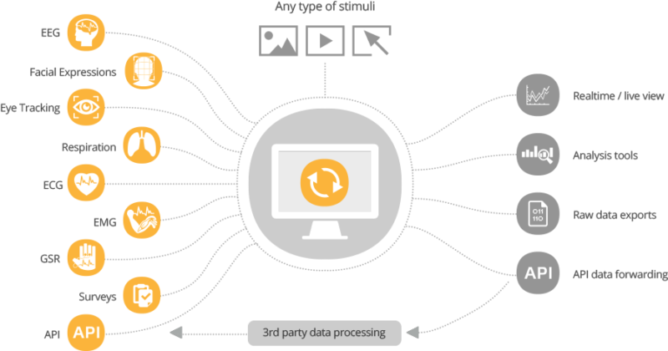
INTEGRATION

Slide 18



What are the existing integration platforms?
(https://imotions.com)
iMotions is one of the leading hardware integration and synchronization platform for biosensors since 2005 and is trusted by some of the largest academic institutions and companies, powering labs and research all over the world. It is headquartered in Copenhagen, Denmark with USA office in downtown Boston, Massachusetts, United States.
(http://www.noldus.com/)
Noldus Information Technology develops and delivers innovative software and hardware solutions and services for the measurement and analysis of behavior. These allow the customers to advance their research, product development, training, and education. Noldus has offices across Europe, North America, and China and is represented by a worldwide network of distributors.
(https://www.biopac.com/)
It provides integration of hardware to measure mostly physiology anywhere, anytime, from any subject with innovative, compatible solutions that can be used by anyone for meaningful discovery & high-quality, scientific interpretation.

Slide 19
CONTENTS
Objective
Scenario
Equipment
a) Eye trackers
b) Facial Expression
c) ECG
d) GSR
e) Hand Movement
f) EEG
g) Seat pressure
Integration solutions
a) IMOTIONS
b) NOLDUS
5) Comparing platforms

Slide 20
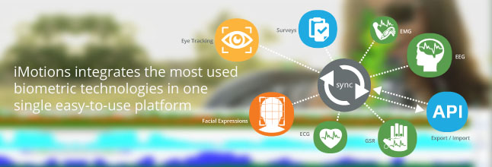
WHAT DOES IMOTIONS PROVIDE?

Slide 21
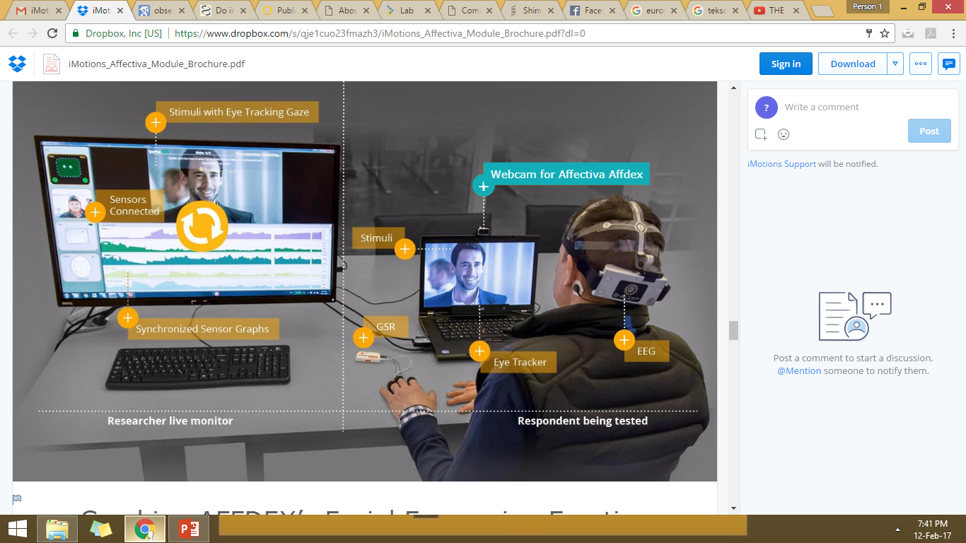

Slide 22
COST OF EQUIPMENTS BY IMOTIONS
EQUIPMENT | INDIVIDUAL PRICING (SGD) | TOTAL PRICE (IN SGD)
Imotions Core License |  | 3401.40
Facial Expression Webcam +Affectiva | Software: 5669 Hardware: Free | 5669
GSR (SHIMMER 3 GSR) | Software:3915 Hardware:1398.25 | 5313.25
ECG(SHIMMER ECG/EMG) | Software:2192 Hardware:1398.25 | 3590.25
Eye tracker(Tobii Glasses 2)(50/100hz)/Tobii X2-60 remote | Software: 6859/8071 Hardware(18845/25629)/14940 | 25704/32488
Hand/Body Getsures(Microsoft Kinect) | Software:Free Hardware: 355 *2 | 710+
Seat Pressure(ConforMat) | Software: 3480 Hardware: 40k | 43480+
EEG (Emotiv Epoc+) | Software:3915 Hardware: 1136+525/30 recording | 5576
 | TOTAL | 44287 + conformat +EEG

Slide 23
CONTENTS
Objective
Scenario
Equipment
a) Eye trackers
b) Facial Expression
c) ECG
d) GSR
e) Hand Movement
f) EEG
g) Seat pressure
Integration solutions
a) IMOTIONS
b) NOLDUS
5) Comparing platforms

Slide 24
Conversation with NOLDUS : SET UP

Slide 25
Two high resolution cameras with pant tilt zoom option and a table microphone. The cameras will be installed on tripods, so that they are portable and no holes need to be drilled.
MediaRecorder is our software tool that will record all the video and audio in sync
For Facial expression, we offer FaceReader and the hardware includes a webcam, which will be placed on the table and an optional LED array on a tripod to optimize the light conditions.
With Noldus The Observer XT the videos from the two cameras and the video and data from FaceReader will be combine into one data set.
Other hardware that is included are three work station with monitor combined in a 19” rack to make your lab more compact and external data storage.

Slide 26
QUOTATION BY NOLDUS
EQUIPMENT | INCLUDES | TOTAL PRICE (IN SGD)
Observer XT | software | 16,400
Face Reader | LED + Lamp Stand | 9100
GSR (Mindware GSR) | GSR and Pulse meter | 27,050
ECG(Empatica ECG/EMG) | wristband | 6050
Eye tracker(Tobii Glasses ) | glasses | 61,150
Hand/Body Getsures( 2 cameras IP PTZ) | Tripod stand +boundary microphones+ microphone preamplifier | 7550
Seat Pressure(ConforMat) | Conformat seat | 31,000
Noldus integration and training | Package | 13,000
 | TOTAL | 1,71,300

Slide 27
CONTENTS
Objective
Scenario
Equipment
a) Eye trackers
b) Facial Expression
c) ECG
d) GSR
e) Hand Movement
f) EEG
g) Seat pressure
Integration solutions
a) IMOTIONS
b) NOLDUS
5) Comparing platforms

Slide 28
What equipment do these company provide?
METHOD | IMOTIONS | NOLDUS | BIOPAC
Eye tracking | Tobii, SMI, EyeTech | Tobii, SMI | EYE-GLASSES-PRO and the EYE-REDN
Facial expression | Affectiva | Face Reader | Interfaces with Noldus
ECG | Shimmer,Biopac | Biopac | Biopac products
GSR | Shimmer,Biopac | Biopac | Biopac products
EEG | Emotiv epoc+ | Biopac | Biopac-EEG100C, CAP100C
Hands/Legs | Any no. of cameras | Any no. of cameras | Any no. of cameras
Integration Software | imotions human behavior software | ObserverXT | MP 160

Slide 29
COMPARISON OF BOTH PLATFORMS
IMOTIONS | BIOPAC+NOLDUS
Integrates Eye tracking, facial expressions, GSR, EEG, ECG and other third party equipment with API. | Observer XT is a software that integrates all data in a similar way.
Eye tracking-Tobii Facial Expression- Affectiva ECG/GSR- Shimmer EEG- Emotiv Epoc+ Kinect- raw files no visualization | Eye tracking-Tobii Facial Expression- Face Reader ECG/GSR- Biopac EEG- Emotiv Epoc+ No kinect
Imotions have a integration of all hardware together from different companies with their own software modifications. | Biopac deals only with physiological data whereas Noldus is known for the Face Reader, so they merge together.
SET UP – They do not have any local staff. They can ship the hardware/software and we set up ourselves, or we provide them travel costs. | They have a local technical staff to set up all hardware/software requirements.
Worked and recommended by major universities like Stanford, MIT Media labs, etc. | Biopac devices are used worldwide in various research labs but Noldus is used by few universities only.

Slide 30
APPENDIX 1
IMOTIONS have been involved in research with Stanford University providing its Attention Tool for eye tracking and facial expression.
Driving Simulator- Powered by the iMotions platform, Stanford University has created one of the world’s most advanced simulators integrating in biometric sensors and other human behavior technologies. By using the live stream from eye tracking glasses and a video feed of someone in the drivers seat, they collected gaze data from the dynamic situation posed by the simulation technology as well as the emotions derived from the facial expressions of the driver.
TrollLabs at NTNU, Stanford’s Center for Design Research and Renault collaborated on the project. The Center for Design Research is a research center at Stanford University. The Center for Design Research was founded in 1984 by a collection of faculty from Stanford's famed Design Division, with money from companies including Apple Computer, BMW, Hewlett-Packard, Sun Microsystems, and Toshiba Corporation.
[1] https://imotions.com/blog/eye-tracking-facial-expression-analysis-driving-simulator/
[2] Mok, Brian, et al. "Emergency, automation off: Unstructured transition timing for distracted drivers of automated vehicles." Intelligent Transportation Systems (ITSC), 2015 IEEE 18th International Conference on. IEEE, 2015.
[3 ]Mok, Brian Ka-Jun, et al. "Timing of unstructured transitions of control in automated driving." Intelligent Vehicles Symposium (IV), 2015 IEEE. IEEE, 2015.

Slide 31
OTHER PAPERS WITH IMOTIONS
TEXAS UNIVERSITY
Palma, Marco, et al. "The Effects of Self-Control on Subsequent Purchasing Decisions." 2016 Annual Meeting, July 31-August 2, 2016, Boston, Massachusetts. No. 235987. Agricultural and Applied Economics Association, 2016.
IOWA STATE UNIVERSITY
Du, P., & MacDonald, E. F. (2014). Eye-Tracking Data Predict Importance of Product Features and Saliency of Size Change. Journal of Mechanical Design, 136(8), 081005.

Slide 32
Appendix 2
RESEARCH WITH NOLDUS:
Noldus, together with partners HAN, TomTom, TNO, Delft University and Green Dino, takes up the challenge to build a driver observation system for human-machine interface (HMI) evaluation studies. The system can collect and interpret information from various sources, such as actual or simulated vehicles, portable navigation devices, cameras, eye trackers, and psycho-physiology.
Noldus, L. P., Spink, A. J., Bollen, R., & Heffelaar, T. (2017). Smart Mobility: Driver State Estimation and Advanced Driver-Vehicle Interfaces. In Mobility Engineering (pp. 11-18). Springer, Singapore.

Slide 33
University of Portland
Zuloaga, K. L., Johnson, L. A., Roese, N. E., Marzulla, T., Zhang, W., Nie, X., ... & Raber, J. (2016). High fat diet-induced diabetes in mice exacerbates cognitive deficit due to chronic hypoperfusion. Journal of Cerebral Blood Flow & Metabolism, 36(7), 1257-1270.
Wageningen University & Research, University of Geneva
He, W., Boesveldt, S., Delplanque, S., De Graaf, C., & De Wijk, R. A. (2017). Sensory-specific satiety: Added insights from autonomic nervous system responses and facial expressions. Physiology & Behavior, 170, 12-18.
Warsaw University of Life Sciences
Kostyra, Eliza, et al. "Consumer facial expression in relation to smoked ham with the use of face reading technology. The methodological aspects and informative value of research results." Meat science 119 (2016): 22-31.

